Slide 1

PERSUASIVE SPEAKING
Week 11
Lecture 2
Coursepack Pg # 243 – 251)

Slide 2

THREE MODES OF PERSUASIVE SPEAKING
Logos – based on strong arguments and evidences
Pathos – appealing to the audience’s emotions
Ethos – presenting your affinity towards goodwill; establishing your credibility

Slide 3
Logos: Developing Arguments that Support your Proposition
Speech backed up by strong reasons and arguments that – as much as possible – cannot be refuted
Appeals to audience’s intelligence and logical thinking
Find reasons to support your main point – they should support your point fully and undeniably
Find evidence to support your reasons – so that the audience cannot deny your reasons and therefore your argument

Slide 4
Arguments
Reasons + Evidence
Staunch support of your proposition

Slide 5
ARGUMENTS
Argument from Example –. ‘A’ was applicable someplace else and therefore can be applied here as well
Argument from Analogy – Single comparable example that is extremely similar to the current situation
Argument from Causation – If ‘A’ led to ‘B’ someplace place, and ‘A’ has occurred here, then we can expect ‘B’ to happen anytime soon
Argument from Sign – Use clues and symbols to cue the truth of your proposition; ‘A’ is the sign that ‘B’ and ‘C’ are connected.

Slide 6

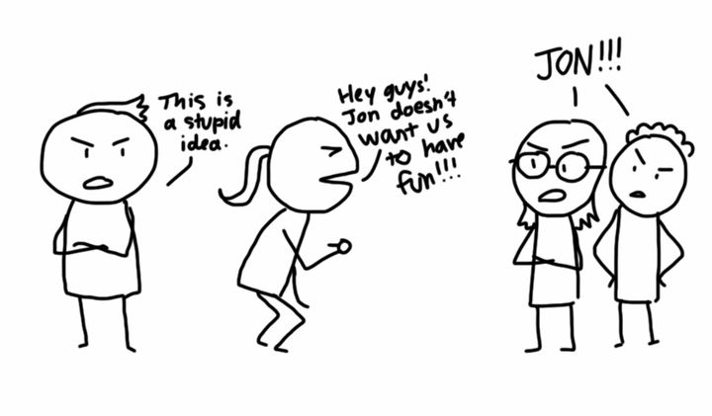
Fallacies
Flaws within the logic or argument; must be avoided in order to create an argument that cannot be refuted.

Slide 7
Fallacies
Hasty Generalizations – assuming – without solid proof – that a certain phenomenon is universal
False Cause – creating an illogical or dubious causal relationship between events/actions/people
Ad Hominem – attacking the opposing speaker instead of tackling their argument itself
Either-Or – suggesting there are only two alternatives and ignoring the plethora of additional options
Straw Person – misrepresenting or misinterpreting the opposing party’s argument and then arguing against the misrepresented argument instead of the actual argument

Slide 8
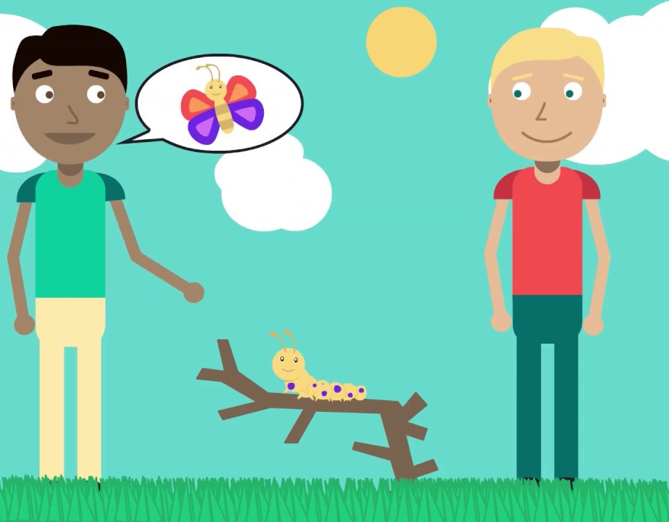
Pathos: Appealing to your Audience’s Emotions
Evoking either positive or negative emotions in your audience to sway them towards your point of view

Slide 9
Pathos: Appealing to your Audience’s Emotions
Negative Emotions – cause the tendency of escapism; people want to escape them and take the route that can offer them the escape. Five most common negative emotions: anger, guilt, sadness, shame, fear.
Positive Emotions – people want to keep feeling them; are attracted towards a proposition that can prolong them. Five most common positive emotions: happiness/joy, cheerfulness, relief, pride, hope, compassion.

Slide 10


Ethos: Establishing Credibility and Goodwill
Credibility of the speaker
Audience will pay attention to a speaker that they believe:
Is credible and trustworthy
Has good intentions towards them
Wants to help them
Understands them and empathizes with them

Slide 11
Ethos: Establishing Credibility and Goodwill
Personalize your information according to your audience – make them feel involved and included
Empathize with your audience – even when you wish to change their belief or point of view, show them that you understand the worldview that they are currently holding and why.
Show your responsiveness to the audience – show them that you care; that you’re listening; refer to any prior or preceding feedback you might have received.
As a persuasive speaker, you can:

